Slide 1
Friend Finder
An iBeacon project – Design for mobile devices

Slide 2
Introduction
Friend Finder – iBeacons project.

Slide 3
Problem
Meeting Friends
Loosing Friends
Saving time and energy

Slide 4
Solving the Problem
HOW?
iBeacons
UOB app
Webservice
Web-app

Slide 5
Technologies
iBeacons
PHP – Webservice
SQL - Database
HTML/CSS - Webbstructure
JavaScript – Interaction
Material Design Light - Framework

Slide 6
How to find your Friend
Find Friend
Find friend in App
Locate Friend
Locate position
Meet Friend
Travel to destination

Slide 7
Result
Two page - website

Slide 8
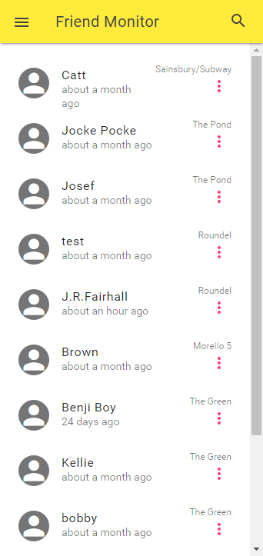
Friend Monitor Homepage - Friends
The index site of the website.
List of contacts.
Time ago since the last beacon was hit.
Location of the contact.

Slide 9
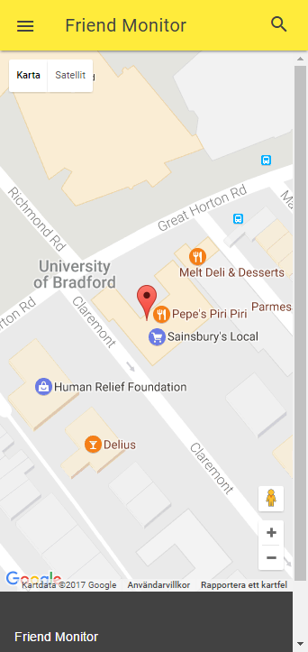
Friend Monitor Maps
When finding a contact this is the page that is shown to the user.

Slide 10
User Testing
Friend Finder

Slide 11
User Testing - Thoughts
PROS
CONS
Interesting & Innovative Idea
Attractive interface
Think that the app can fulfill it’s purpose.
Confusing with not working buttons and functions.
Non mobile friendly interactions - Clicking a contact in the list.
The purpose of the app were not obvious without a introduction.

Slide 12
Thank you for your time! By Benjamin Karlsson

